Slide 1
CAPSTONE PROJECT1 (MARKETING DATA)
BATCH A, GROUP 1
Checkpoint 1

Slide 2
Members and Responsibilities

Slide 3
TASK 1.1 (Data manipulation using Python)

Slide 4
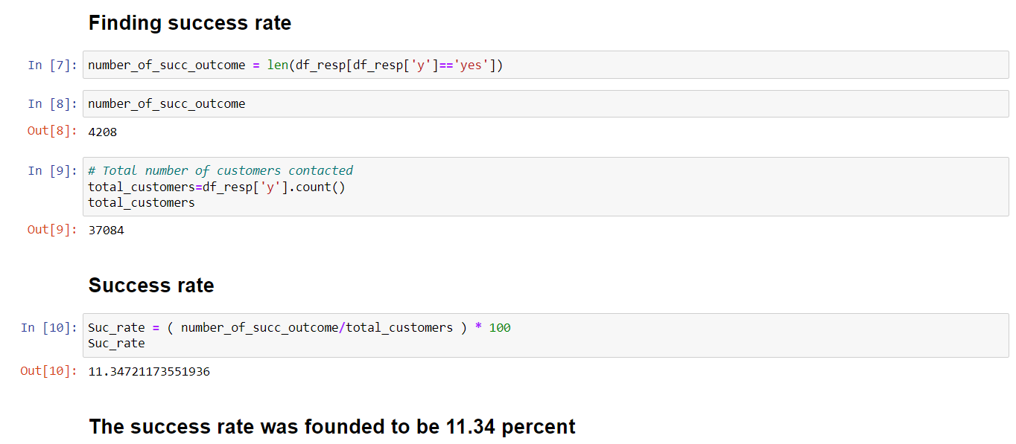
Success Rate of the campaign
Approach
The number of people who had a positive response in the present campaign was found out and the ratio between this number and the total number of people in the campaign was taken to find the success rate of the campaign.

Slide 5
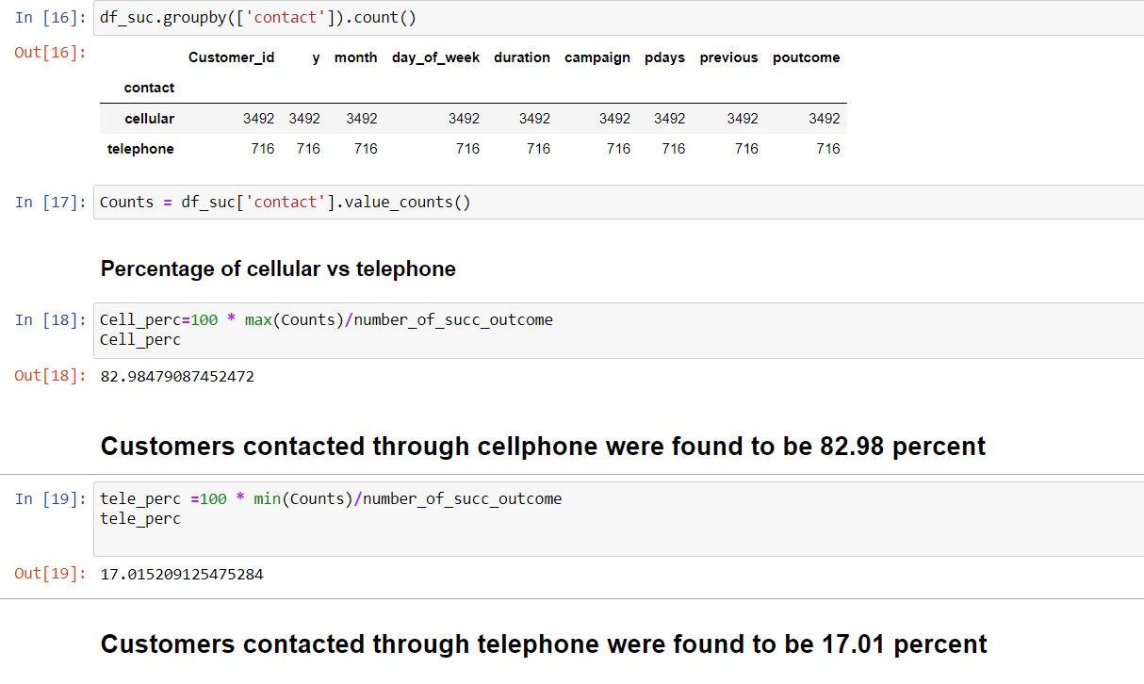
Right Mode of Contact
Approach
The tables having Data on customer responses and customer campaign details were merged and the columns having success response were grouped together along with the corresponding mode of contact
From the grouping the percentage of people who were contacted through telephone and mobile were found out.

Slide 6
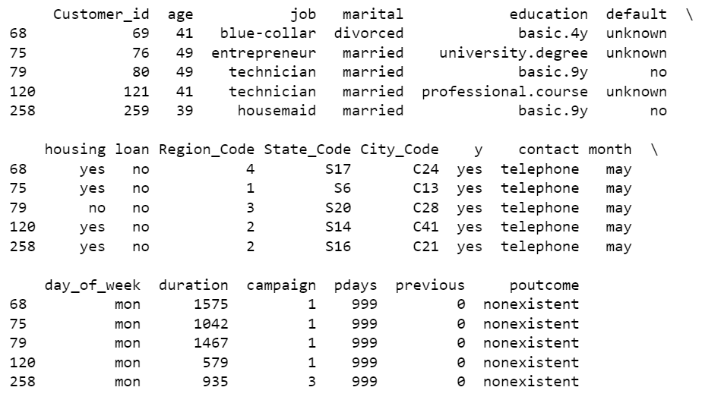
Attempts made to convert a person into a successful depositor
Approach
The people who said yes was filtered from the merged table and then was compared with the distinct values or number of attempts made in terms of percentage. The number of people who said yes was found out and was compared with the number of people who responded yes in the distinct number of attempts and based on that the percentage was found

Slide 7




Approximately half of the people who were successfully converted as a depositor was only contacted once
More than 95% of the people who were successfully converted into a depositor was contacted less than or equal to 5 times.
Only about 4% of people who were turned into depositor was contacted more than 5 times

Slide 8
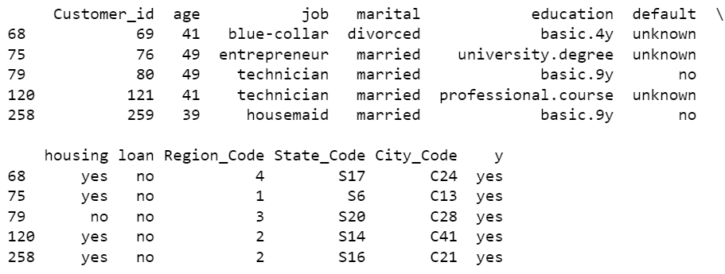

Customers’ Personal Data Analysis
Approach
The people who said yes was filtered from the merged table. The number of people who said yes was found out from this table. Each of the distinct values or trait of each personal data is then compared with the total number of people who said yes. The count of each trait was found out and then using the total number of person who said yes, the percentage of people with a distinct trait who said yes was found out for comparison.

Slide 9

The most of person who said yes had university degree and below them was people who studied till high school. The least person who have said yes are illiterate people
More than half of the people who said yes had an existing housing loan

Slide 10
The most people who said yes is employed in administration. The second most number of people who said yes was employed as technician and then is having a blue collar job The people who were self employed and unemployed who said yes was almost equal
Most people who said yes doesn’t have an existing personal loan

Slide 11
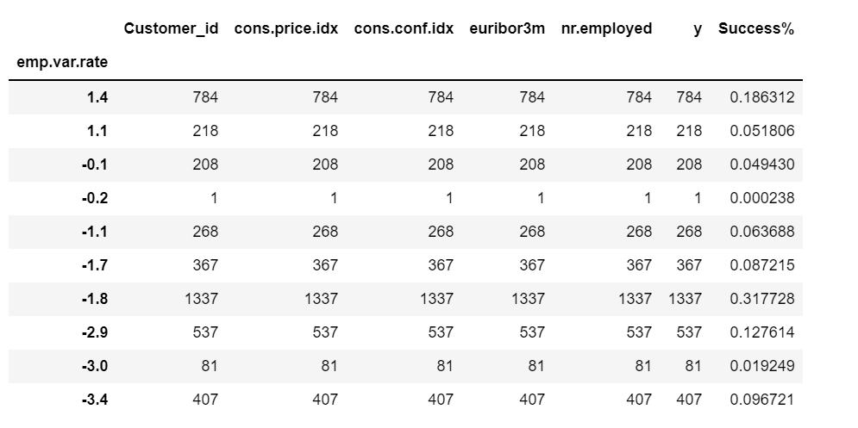
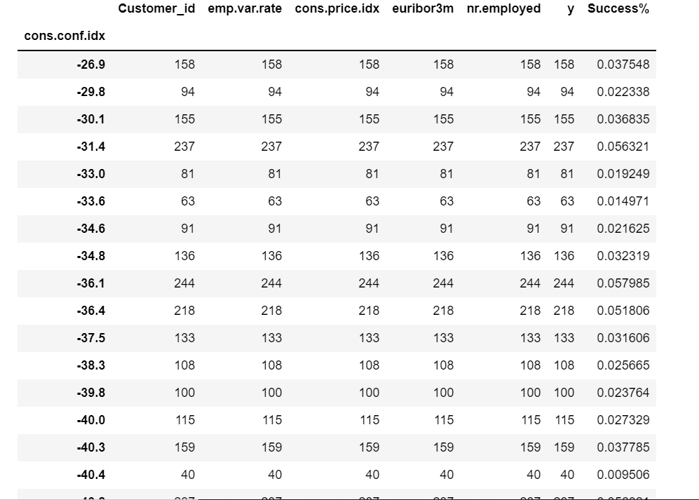
Socio - Economic Analysis of Customers
Approach
We try to find any correlation between the different social and economic indicators and the success percentage for customers having those indicators.
For this, we will try to ascertain whether the no. of customers saying YES are proportional to the increasing or decreasing indicators value or not.
First, we filter out the customers saying YES from the dataset. Then we groupby them as per different social and economic indicators.
Next, we will calculate the success percentage for each value of an indicator. For this we will divide the aggregate count of YES for each value to the total number of YES counts.

Slide 12
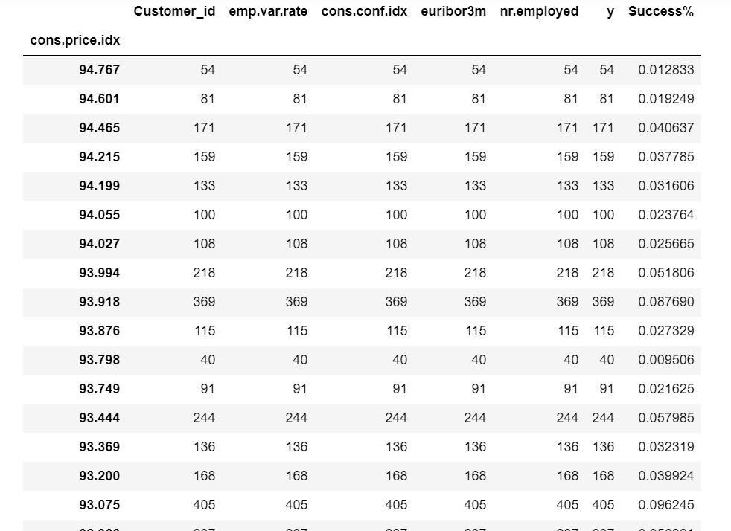
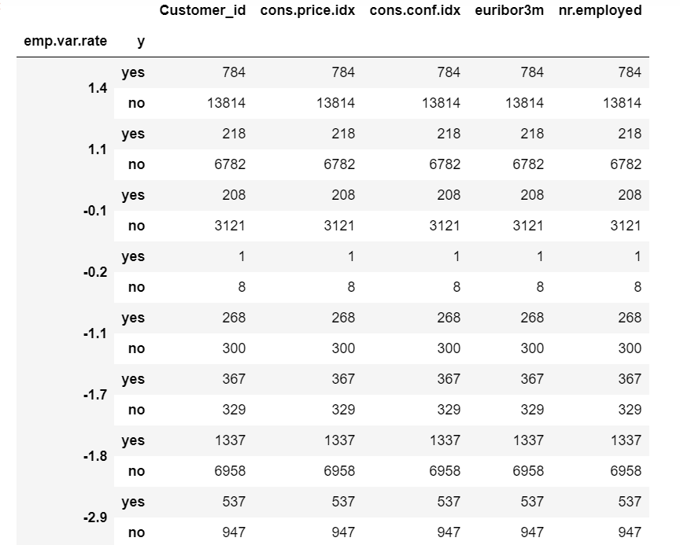
Judging from the data, we can certainly say that the success percentage i.e. the number of customers accepting the bank’s scheme is not directly or inversely proportional to any social and economic indicator.
We can also represent the dataframe grouped by indicators and the no. of successful and unsuccessful cases per value. Example:

Slide 13
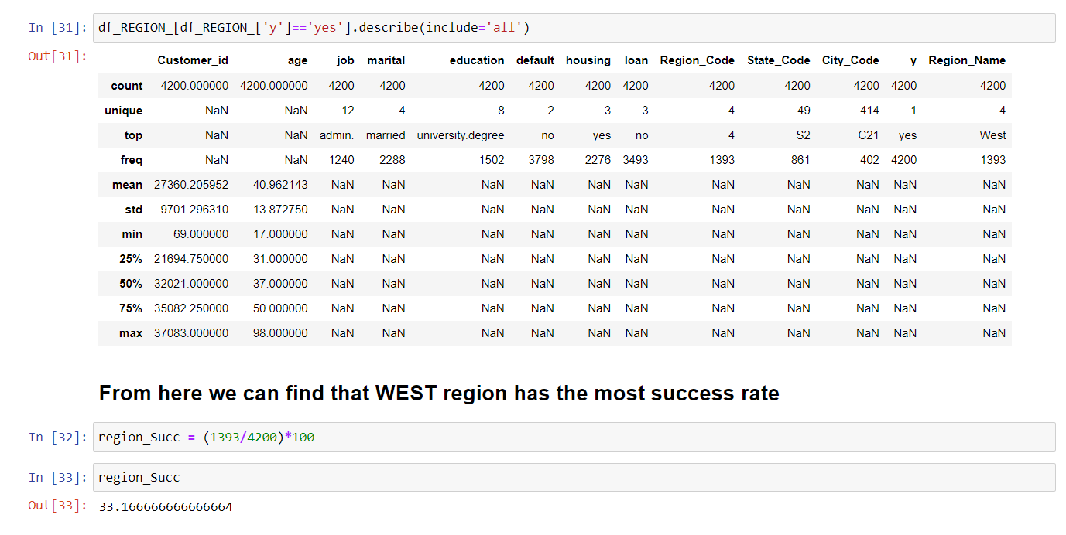
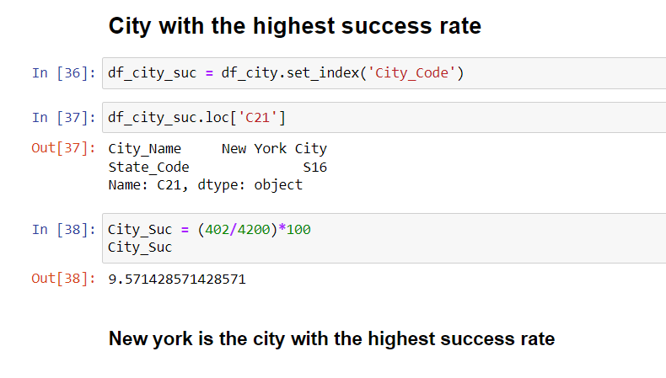
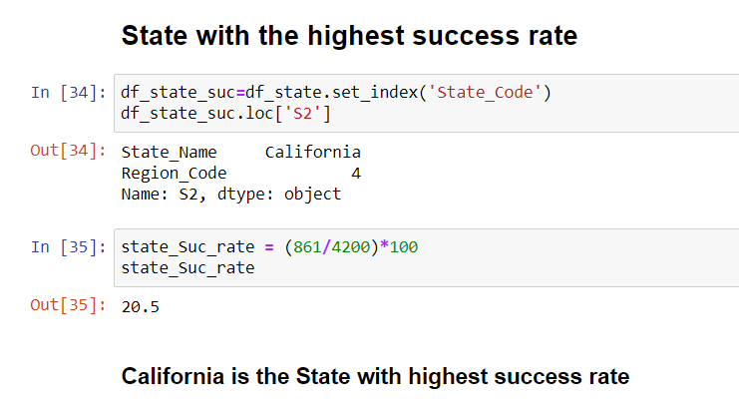
Demographic Analysis of Customers
Approach
The tables having Data on customer responses and customer bank details were merged with the tables having data on state code and city code and region code and the rows with success responses were grouped together.
From the grouping , the State, Region, City having the highest success rate was found out.

Slide 14
TASK 1.3 (Statistical Analysis using Python)

Slide 15
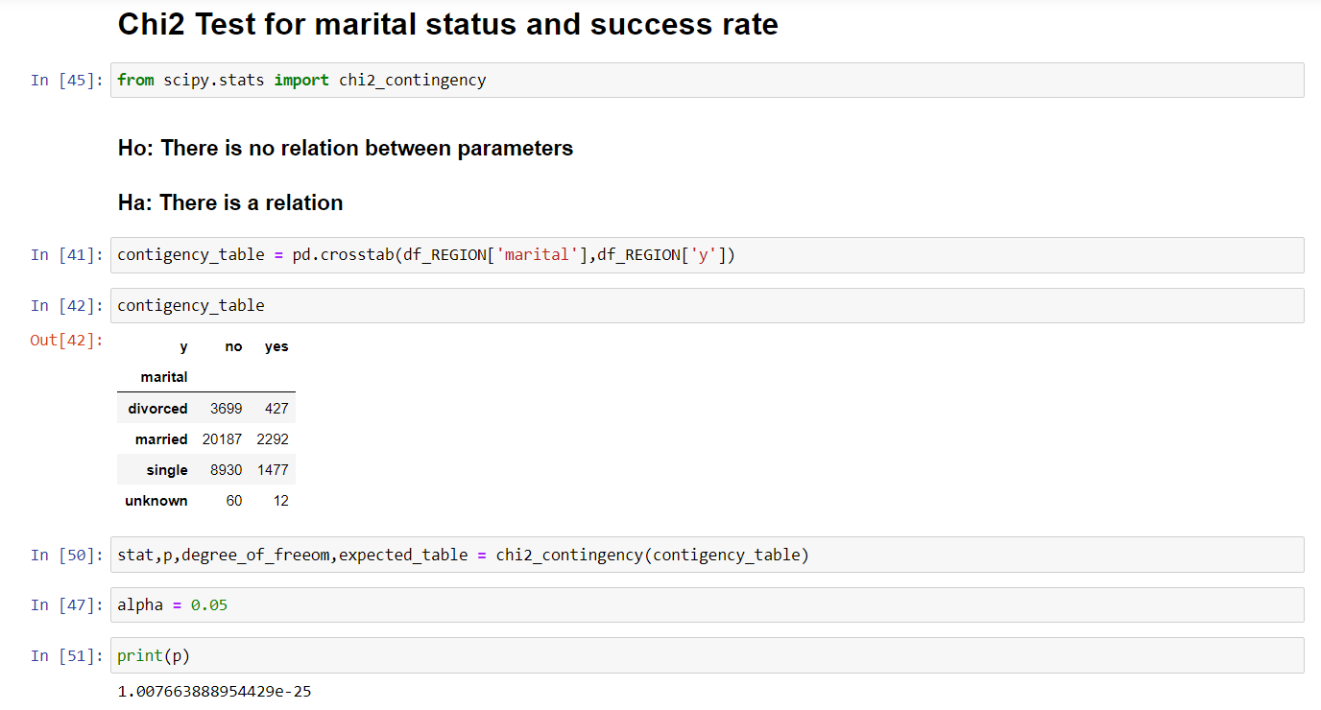
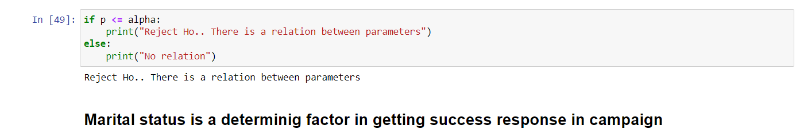
Hypothesis Testing on Marital Status
Approach
The tables having Data on customer responses and customer bank details were merged and the column married status and response (‘y’) were taken.
From these contingency table was found out and ‘P’ value was found out.

Slide 16
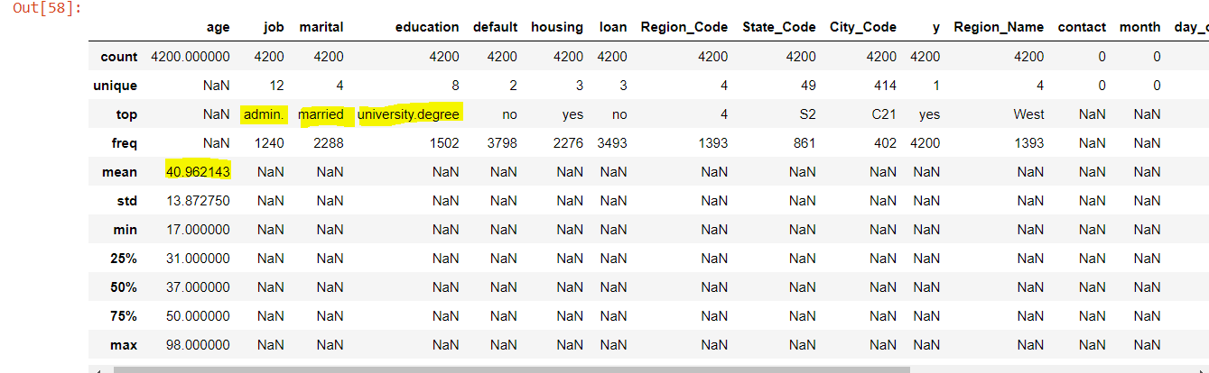
Statistical Analysis of campaign
Approach
The tables having Data on customer responses, customer bank details, customer campaign details were merged. From this table insights into various parameters were found out.
Customers who were married and who held a university degree were more likely to have favorable response. Also, customers with admin jobs were likely to have a successful response to the campaign. The mean age of the people who said yes was 40~41. We can conclude that people who are financially stable are more likely to respond favorably to a campaign.

Slide 17
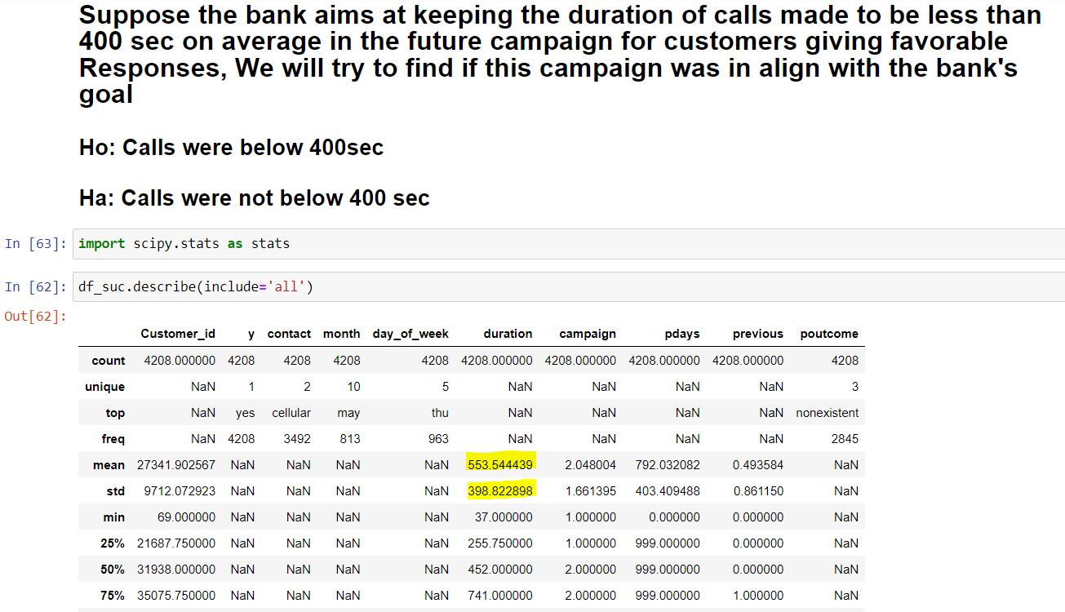
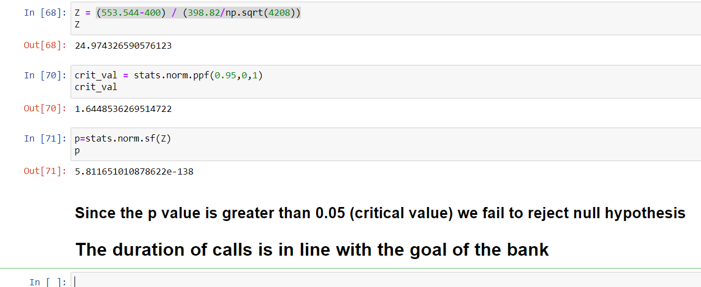
Analysis of the phone call duration made to the customers using Z- Test
Approach
The tables having Data on customer responses customer campaign details were merged. From this table insights into call duration was found out.
Customers who were married and who held a university degree were more likely to have favorable response. Also, customers with admin jobs were likely to have a successful response to the campaign. The mean age of the people who said yes was 40~41. We can conclude that people who are financially stable are more likely to respond favorably to a campaign.

